Slide 1

Privacy 101 Strategies and tools

Slide 2
What are your
privacy concerns?
https://libraryfreedomproject.org

Slide 3
Privacy technology
Free and open source software
Data minimization
Strong encryption
We’ll talk about the friction and difficulty level of each of these recommended tools and strategies
https://libraryfreedomproject.org

Slide 4
General
Update your software
Be cautious about links and attachments
Only download software from trusted sites
Delete unused apps
Make hard drive backups
Use social media minimally
https://libraryfreedomproject.org

Slide 5
Passwords
Strong, complex, and unique
Master password
Password manager
2 factor authentication
Security questions
Mobile devices
https://libraryfreedomproject.org

Slide 6
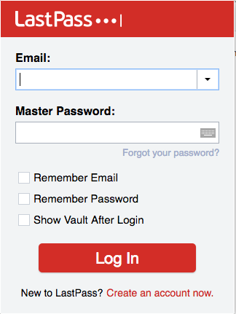
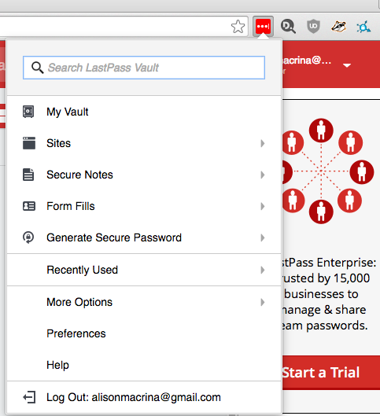
https://libraryfreedomproject.org

Slide 7
Web browsers
Chrome vs Firefox
Tor Browser vs everything else
Look for HTTPS on websites
Download software only from trusted sites
DuckDuckGo > Google
Adblocking
https://libraryfreedomproject.org

Slide 8
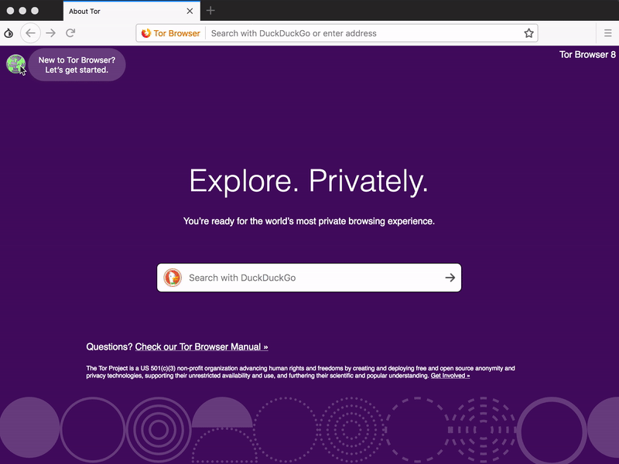

Slide 9
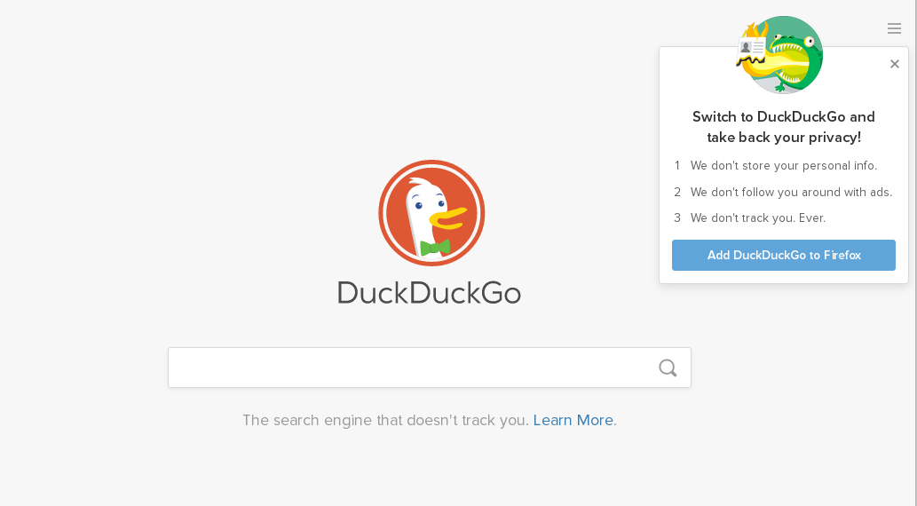
A more private search engine:
duckduckgo.com
https://libraryfreedomproject.org

Slide 10
Ad blockers
Privacy Badger
Ghostery
Ad-block Plus
DisconnectMe
1Blocker
https://libraryfreedomproject.org

Slide 11
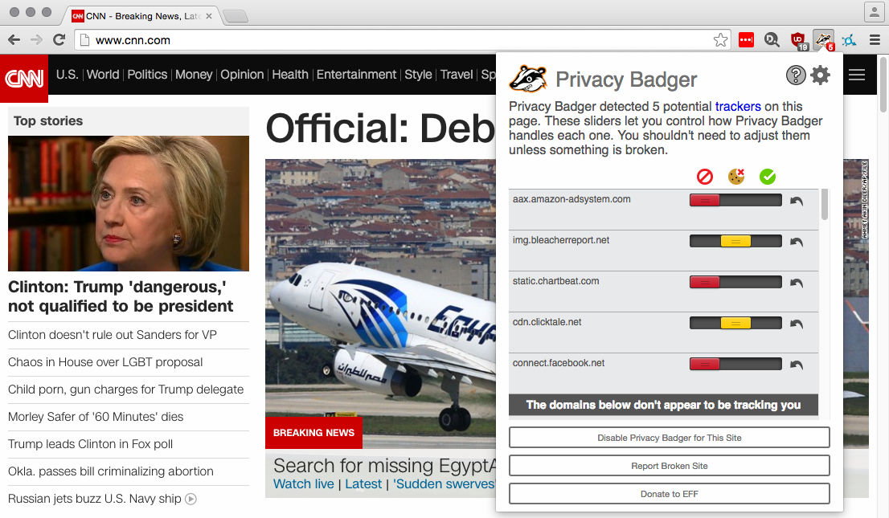
Basic best practices
https://libraryfreedomproject.org

Slide 12
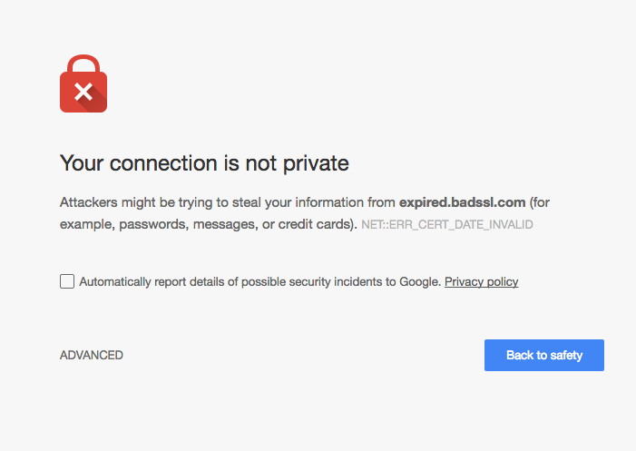
HTTPS
https://libraryfreedomproject.org

Slide 13

HTTPS
https://libraryfreedomproject.org

Slide 14
Texting
Regular SMS
iMessage
Whatsapp
Signal
https://libraryfreedomproject.org

Slide 15
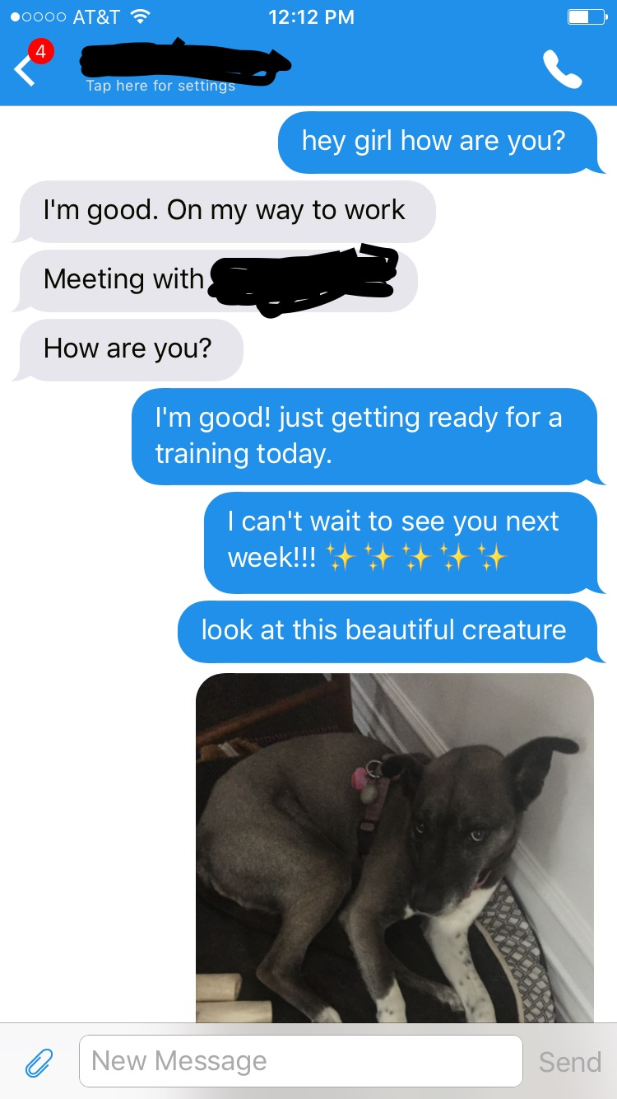
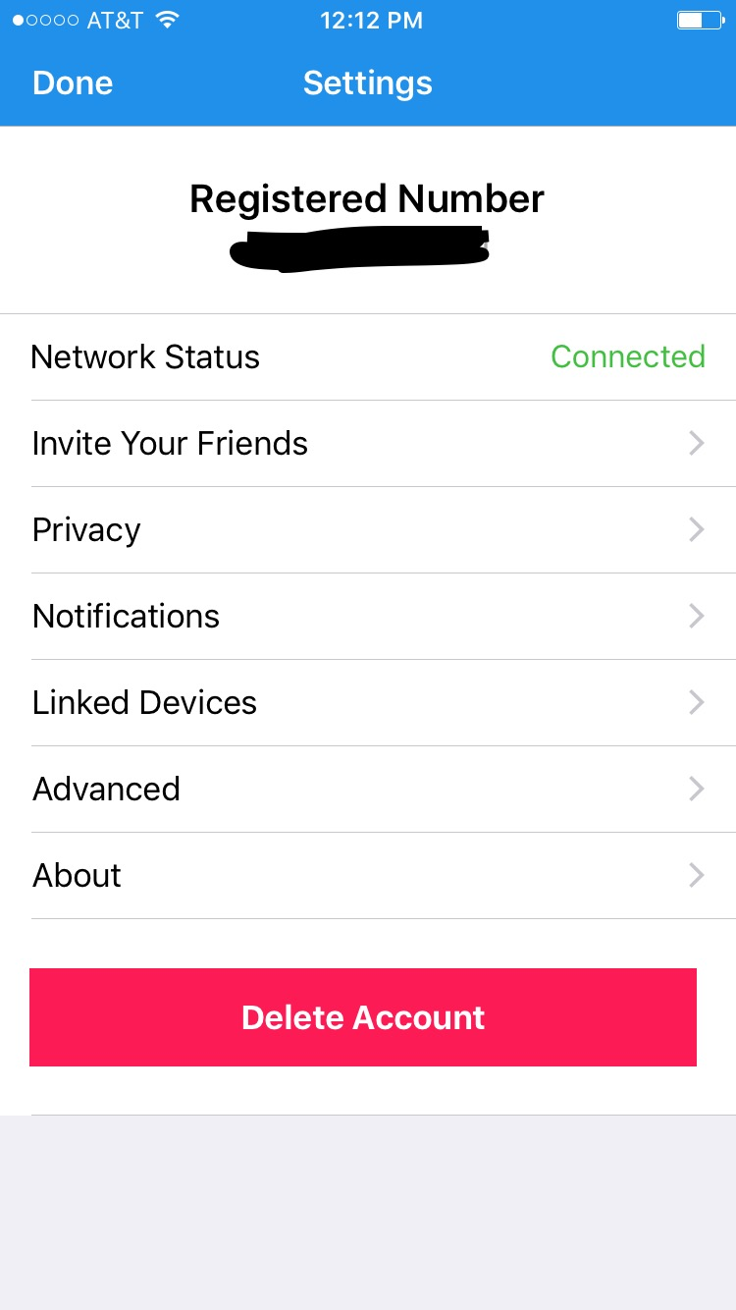
Signal
Encrypted texting, calling, video chat
Android, iOS, MacOS, Windows, Linux
No stored metadata
Totally free
How does it compare to Whatsapp?
https://libraryfreedomproject.org

